Slide 1


Slide 2
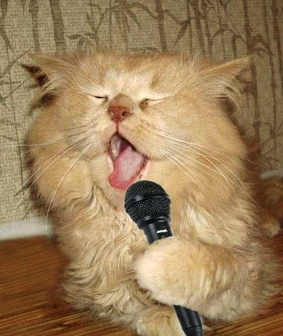
PROBLEM
You’re surfing the Web, and you just can’t get that damn song out of your head. What to do? Where can you sing your heart out and be entertained by memes and GIFs at the same time?
Notes:
You see a meme on the Internet

Slide 3





HOW IT WORKS

Slide 4




Step 1:
LOAD TRACKS
Curated list of popular (i.e. meme-worthy) Artists
ARTIST NAMES
Artist Database
JSON
List of corresponding Artist IDs
ARTIST IDs
Album & Track Database
List of Tracks for each Artist ID
JSON

Slide 5
Step 2:
PICK TRACK, LOAD LYRICS
Track is chosen from list of songs
TRACK ID
Lyrics Database
JSON
List of lyrics* of the chosen Track
* only 30% of the lyrics are provided by the free API, for full lyrics with timings, paid subscription is required

Slide 6
Step 3:
LOAD GIFS
Track is chosen from list of songs
ARTIST NAME
Animated GIFs Database
JSON
List of URLs of animated GIFs of the Artist of the chosen Track

Slide 7

Step 4:
LOAD AUDIO
Track is chosen from list of songs
TRACK ID
Audio Database
AUDIO STREAM
Embedded Soundcloud player

Slide 8

Step 5:
SING!
LYRICS
GIFS
AUDIO

Slide 9

Step 6:
SHARE!
LYRICS
GIFS
SHORT
URL
AUDIO

Slide 10

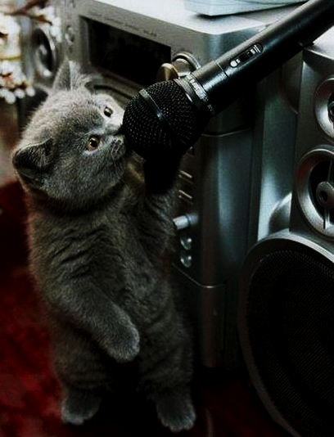
DEMO-OKE!
♫
♬
♩

Slide 11
CHALLENGES FACED
Originally used Spotify, but ran into technical issues (requires Spotify login always) → changed to Soundcloud
Originally used Echonest, but requires special approval from Lyricfind sales team → changed to Musixmatch
Needed to ensure that enough content existed for each artist and track across ALL APIs (audio, lyrics, GIFs)
LRC files (timed lyrics) - no API provides them for free → reverted to static lyrics
Static lyrics - not 100% available for free → stuck with the free 30% anyway
Songs on Soundcloud - not official, mostly covers, multiple versions

Slide 12

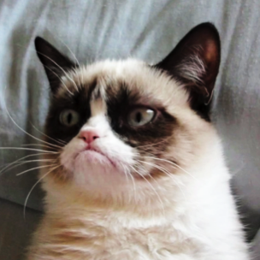

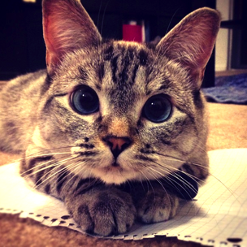
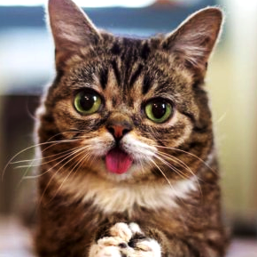
THANK YOU
ANUBHAV
SINDHUJA
STEPHANIE
CARLOS

